Slide 1
Array & Pointers

Slide 2
Array
An array is defined as finite ordered collection of homogenous data, stored in contiguous memory locations.
Here the words,
finite means data range must be defined.
ordered means data must be stored in continuous memory addresses.
homogenous means data must be of similar data type.

Slide 3
Syntax of Array
Syntax:
data_type array_name[size];
Example:
int arr[5];
Here, array named as arr is declared with size 5. It means array arr can store 5 integer data values.

Slide 4
Initialization of an Array
After an array is declared it must be initialized. Otherwise, it will contain garbage value(any random value). An array can be initialized at either compile time or at runtime.
Compile time Array initialization
Runtime Array initialization

Slide 5
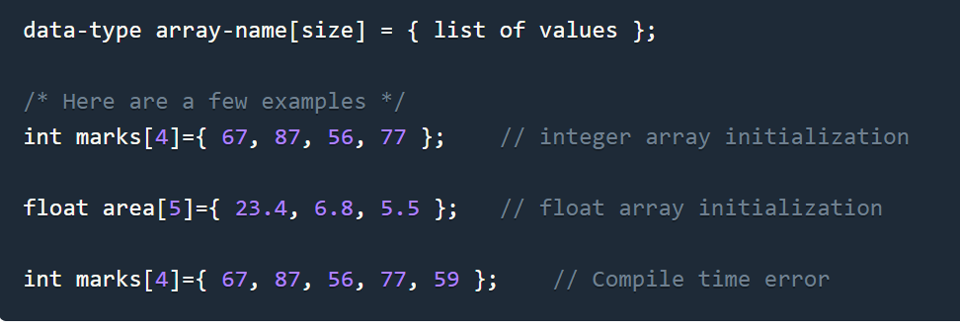
Array: Compile time Array initialization
Compile time initialization of array elements is same as ordinary variable initialization. The general form of initialization of array is,

Slide 6
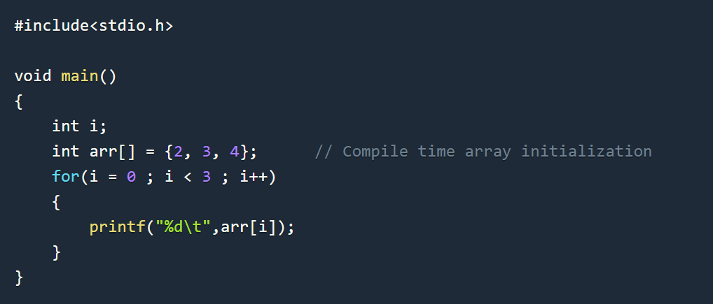
Array: Compile time Array initialization
Compile time initialization of array elements is same as ordinary variable initialization. The general form of initialization of array is,

Slide 7
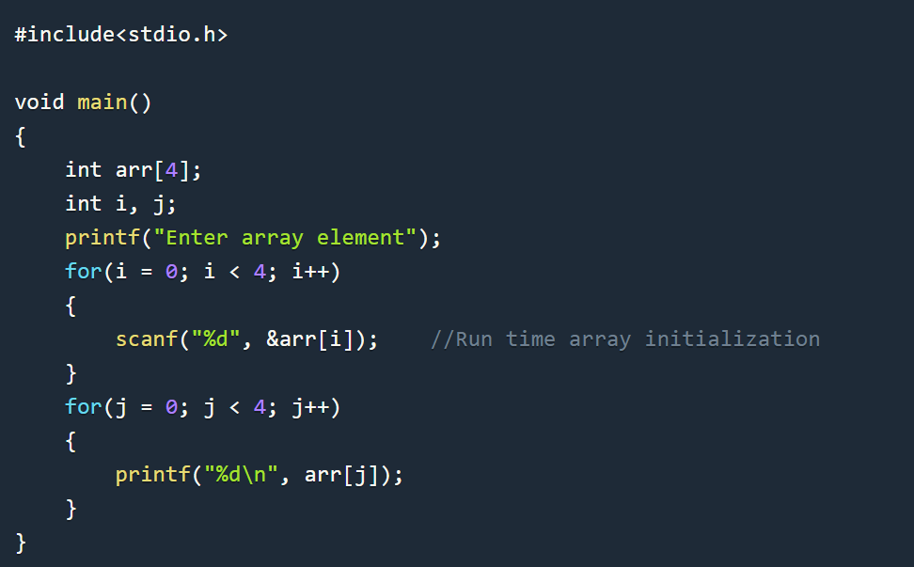
Array: Runtime Array initialization
An array can also be initialized at runtime using scanf() function.
This approach is usually used for initializing large arrays, or to initialize arrays with user specified values. Example,

Slide 8
Array Example Program
Practice Program: Write a Program which will assign value 0 to all array elements.

Slide 9
TYPES OF C ARRAYS
There are 2 types of C arrays. They are,
One dimensional array
Multi dimensional array
Two dimensional array
Three dimensional array
four dimensional array etc…

Slide 10
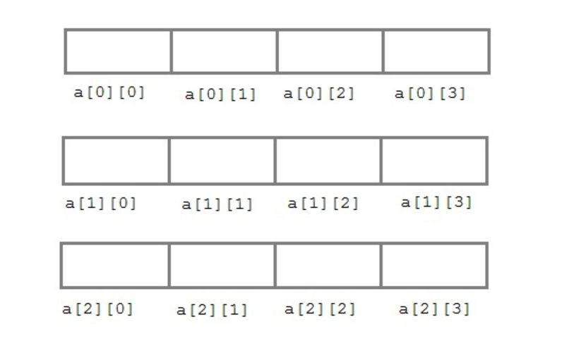
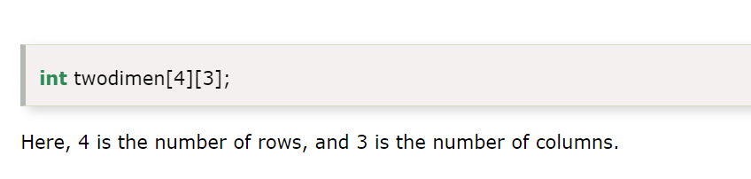
2D Array
TWO DIMENSIONAL ARRAY IN C:
Two dimensional array is nothing but array of array.
syntax : data_type array_name[num_of_rows][num_of_column];
int a[3][4];

Slide 11
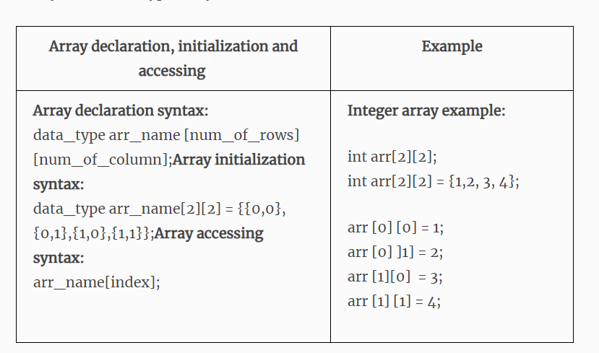
2D Array

Slide 12
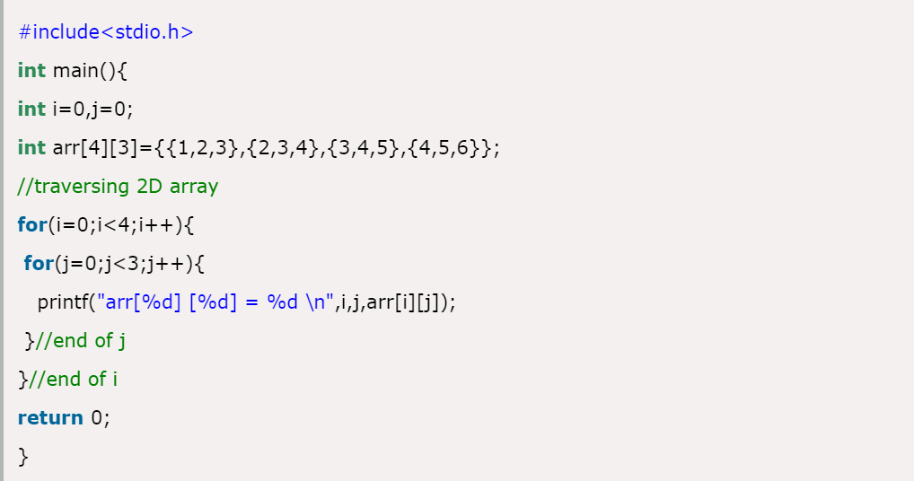
2D Array

Slide 13
C Pointers
The pointer in C language is a variable which stores the address of another variable.
This variable can be of type int, char, array, function, or any other pointer.
The size of the pointer depends on the architecture. However, in 32-bit architecture the size of a pointer is 2 byte.

Slide 14
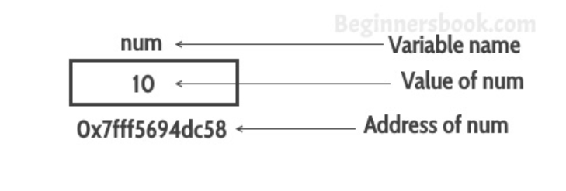
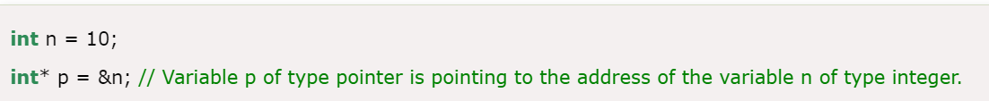
C Pointers

Slide 15
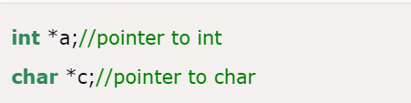
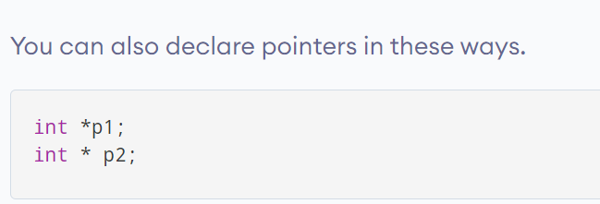

Declaring a pointer
The pointer in c language can be declared using * (asterisk symbol).

Slide 16
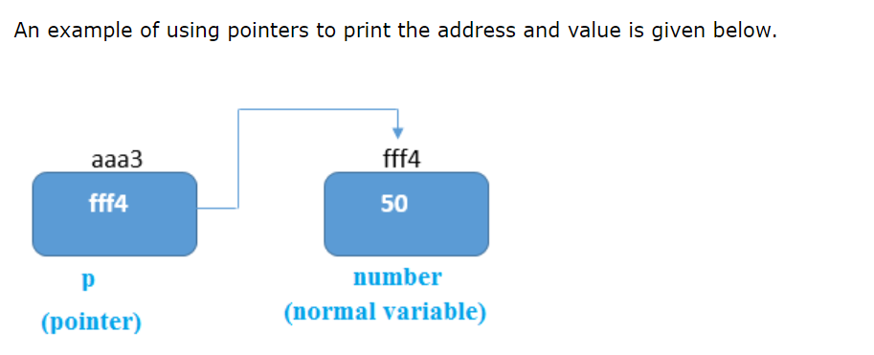
C Pointers

Slide 17
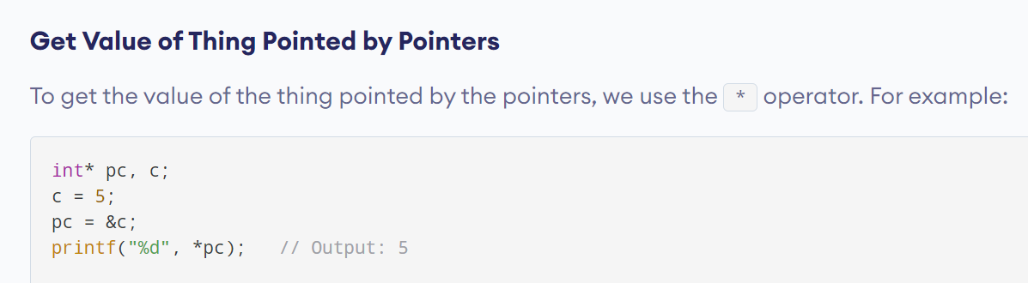
Get Value of Thing Pointed by Pointers

Slide 18
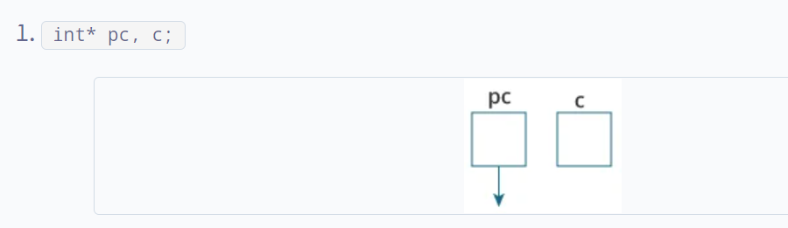
Explanation of the program

Slide 19
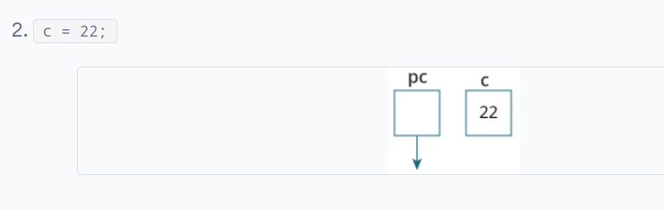
Explanation of the program

Slide 20
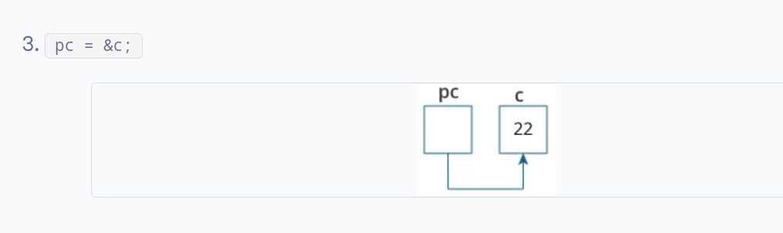
Explanation of the program

Slide 21
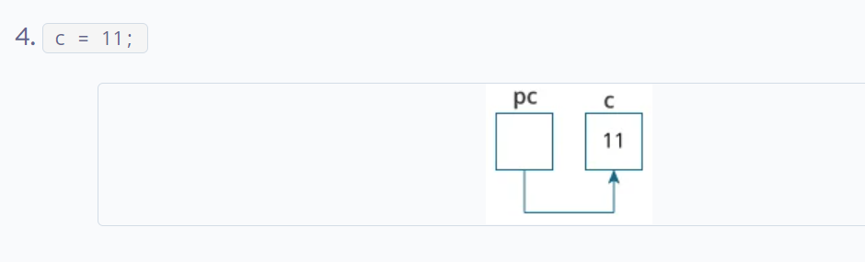
Explanation of the program

Slide 22
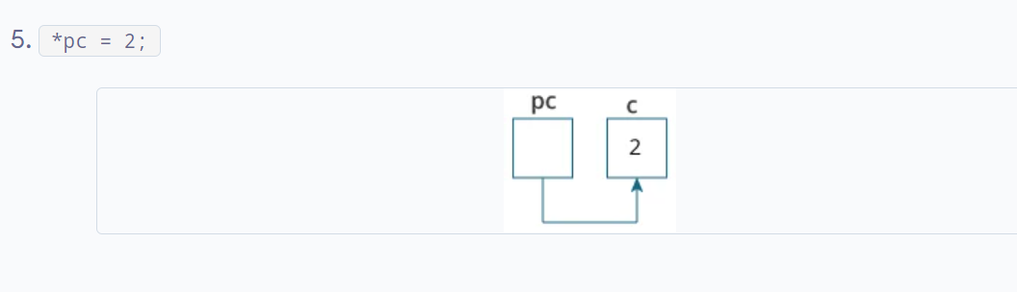
Explanation of the program

Slide 23
Usage of pointer
There are many applications of pointers in c language.
1) Dynamic memory allocation
In c language, we can dynamically allocate memory using malloc() and calloc() functions where the pointer is used.
2) Arrays, Functions, and Structures
Pointers in c language are widely used in arrays, functions, and structures. It reduces the code and improves the performance.

Slide 24
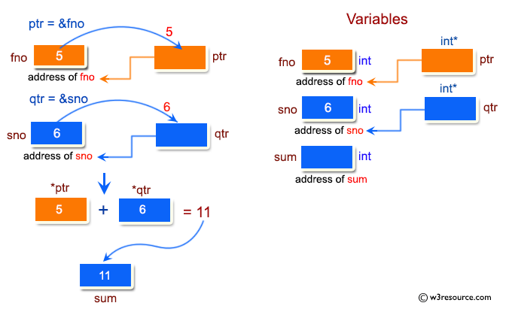
Programming Exercise
Write a program in C to add two numbers using pointers.

Slide 25

Character Array & Pointers
String is a sequence of characters which we save in an array. And in C programming language the \0 null character marks the end of a string.
Creating a string
In the following example we are creating a string str using char character array of size 6.

Slide 26
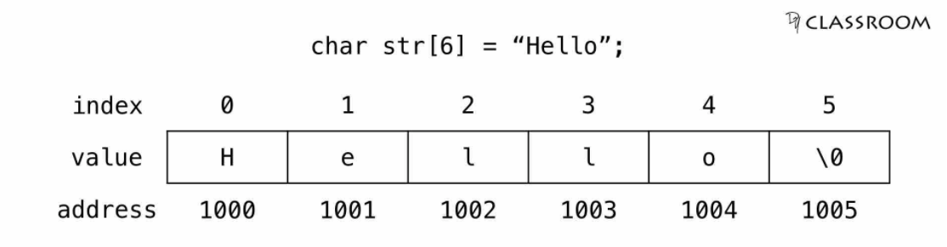
Character Array & Pointers

Slide 27
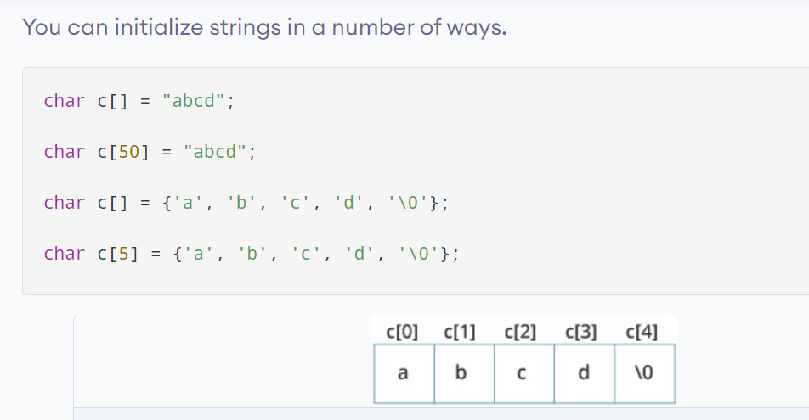
Character Array & Pointers

Slide 28
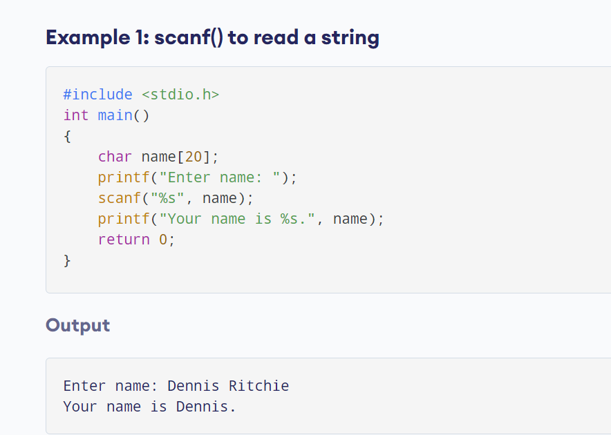
Character Array & Pointers

Slide 29
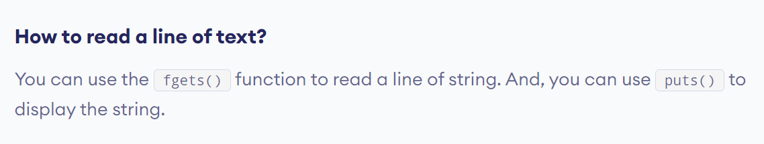
Character Array & Pointers

Slide 30
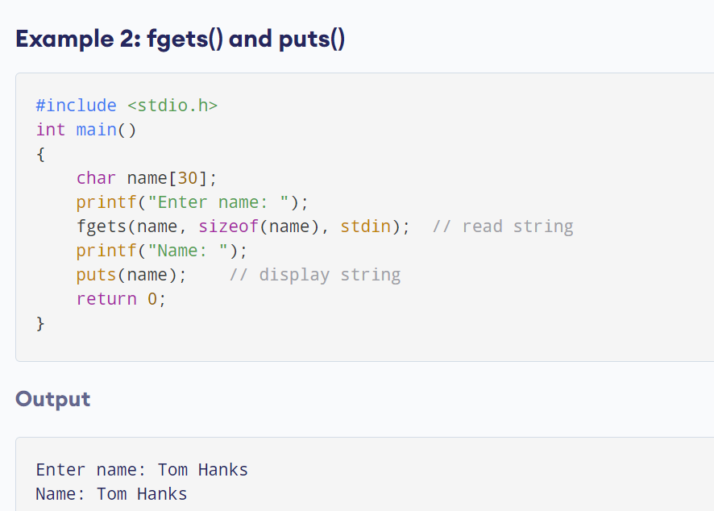
Character Array & Pointers

Slide 31
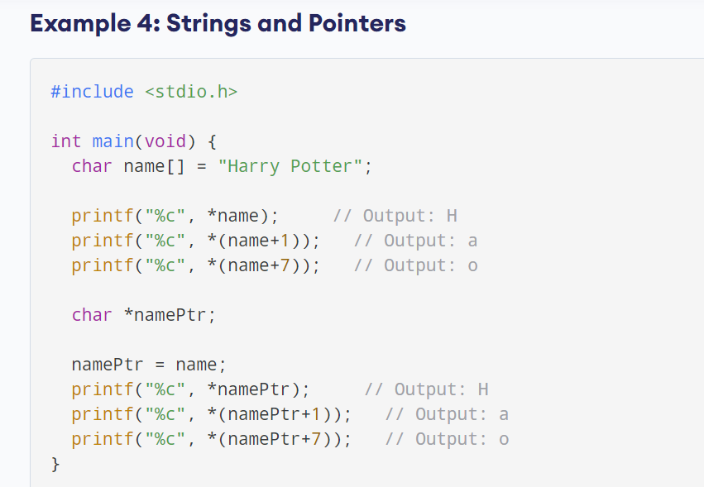
String & Pointer

Slide 32
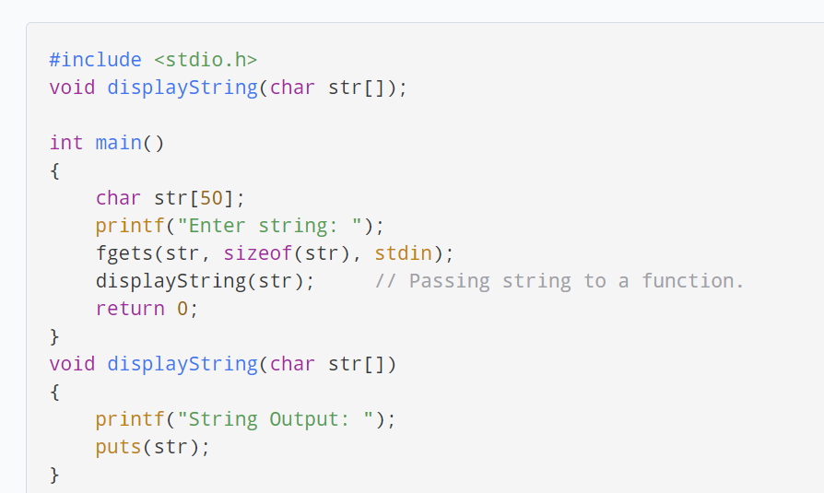
String & Pointer: Passing string to a Function

Slide 33
C Pointers
1) Pointer to Pointer – A pointer can point to another pointer (which means it can store the address of another pointer), such pointers are known as double pointer OR pointer to pointer.
2) Passing pointers to function – Pointers can also be passed as an argument to a function, using this feature a function can be called by reference as well as an array can be passed to a function while calling.
3) Function pointers – A function pointer is just like another pointer, it is used for storing the address of a function. Function pointer can also be used for calling a function in C program.

Slide 34

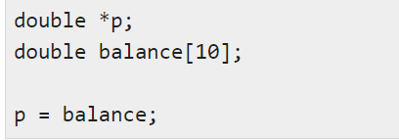
Pointer to an Array
An array name is a constant pointer to the first element of the array. Therefore, in the declaration −
balance is a pointer to &balance[0], which is the address of the first element of the array balance. Thus, the following program fragment assigns p as the address of the first element of balance −

Slide 35
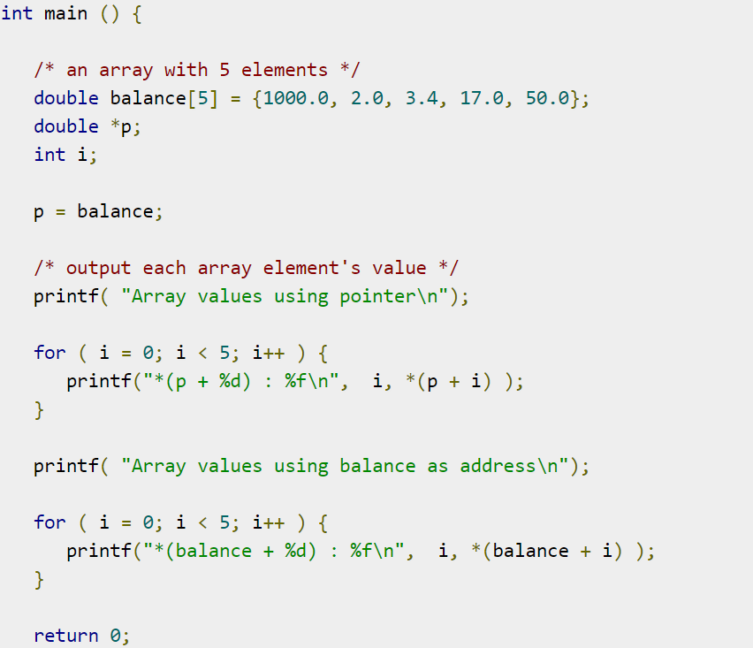
Pointer to an Array
Once you store the address of the first element in 'p', you can access the array elements using *p, *(p+1), *(p+2) and so on.

Slide 36
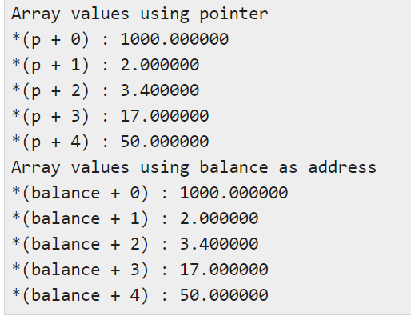
Pointer to an Array
Once you store the address of the first element in 'p', you can access the array elements using *p, *(p+1), *(p+2) and so on.

Slide 37
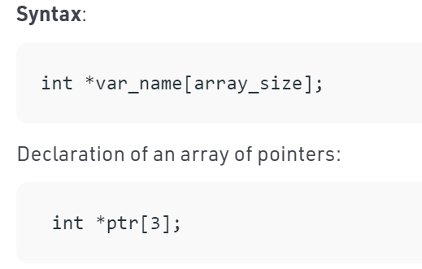
Array of pointers
“Array of pointers” is an array of the pointer variables.

Slide 38
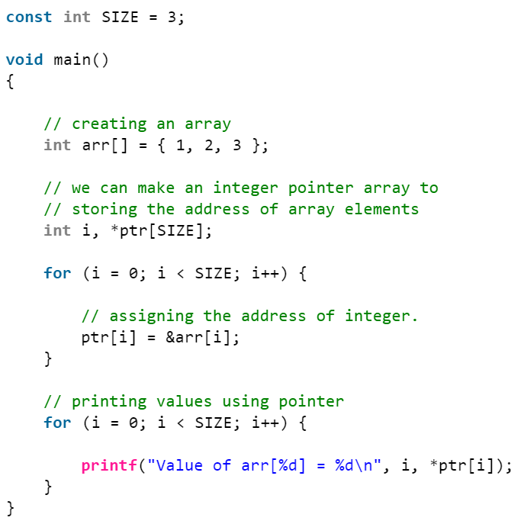
Array of pointers

Slide 39
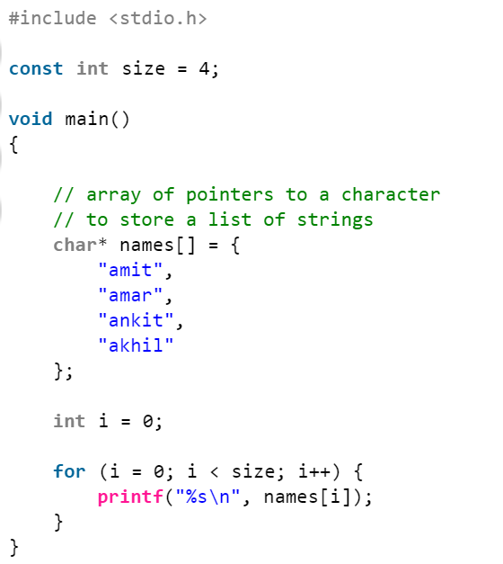
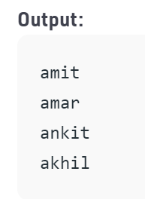
Array of pointers
We can likewise make an array of pointers to the character to store a list of strings.

Slide 40
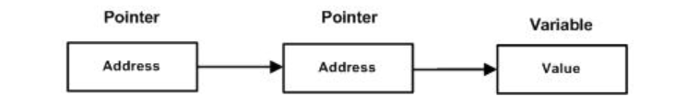
Pointer to Pointer
A pointer to a pointer is a form of multiple indirection, or a chain of pointers. Normally, a pointer contains the address of a variable.
When we define a pointer to a pointer, the first pointer contains the address of the second pointer, which points to the location that contains the actual value as shown below.

Slide 41

Pointer to Pointer
A pointer to a pointer is a form of multiple indirection, or a chain of pointers. Normally, a pointer contains the address of a variable.

Slide 42
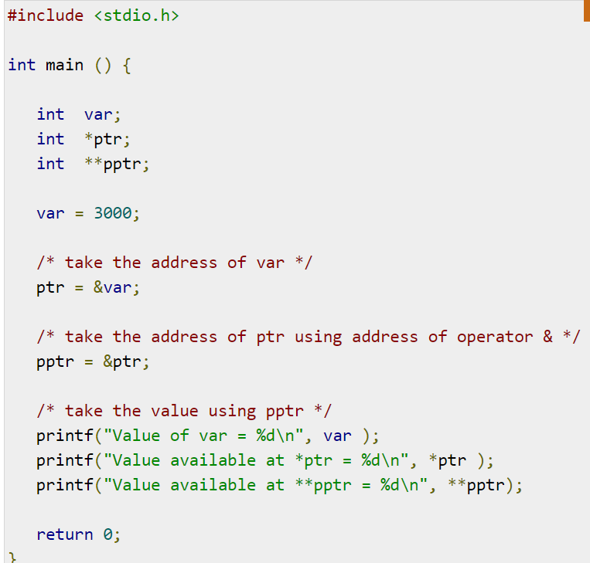
Pointer to Pointer

Slide 43
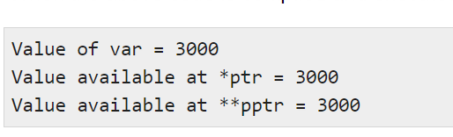
Pointer to Pointer

Slide 44
Pointer Arithmetic
A pointer in c is an address, which is a numeric value. Therefore, you can perform arithmetic operations on a pointer just as you can on a numeric value.
Hence, there are only a few operations that are allowed to perform on Pointers in C language.
The operations are slightly different from the ones that we generally use for mathematical calculations. The operations are:
Increment/Decrement of a Pointer
Addition of integer to a pointer
Subtraction of integer to a pointer
Subtracting two pointers of the same type

Slide 45
Pointer Arithmetic:Increment/Decrement of a Pointer
Increment: It is a condition that also comes under addition. When a pointer is incremented, it actually increments by the number equal to the size of the data type for which it is a pointer.
For Example:
If an integer pointer that stores address 1000 is incremented, then it will increment by 2(size of an int) and the new address it will points to 1002. While if a float type pointer is incremented then it will increment by 4(size of a float) and the new address will be 1004.

Slide 46
Pointer Arithmetic:Increment/Decrement of a Pointer
Decrement: It is a condition that also comes under subtraction. When a pointer is decremented, it actually decrements by the number equal to the size of the data type for which it is a pointer.
For Example: If an integer pointer that stores address 1000 is decremented, then it will decrement by 2(size of an int) and the new address it will points to 998. While if a float type pointer is decremented then it will decrement by 4(size of a float) and the new address will be 996.

Slide 47
Pointer Arithmetic:Increment/Decrement of a Pointer
#include <stdio.h>
int main()
{
int N = 4;
int *ptr1, *ptr2;
ptr1 = &N;
ptr2 = &N;
printf("Pointer ptr1 before Increment: ");
printf("%p \n", ptr1);
ptr1++;
printf("Pointer ptr1 after“ Increment: ");
printf("%p \n\n", ptr1);
printf("Pointer ptr1 before"
" Decrement: ");
printf("%p \n", ptr1);
ptr1--;
printf("Pointer ptr1 after"
" Decrement: ");
printf("%p \n\n", ptr1);
return 0;
}

Slide 48
Pointer Arithmetic : Addition
Addition
When a pointer is added with a value, the value is first multiplied by the size of data type and then added to the pointer.

Slide 49
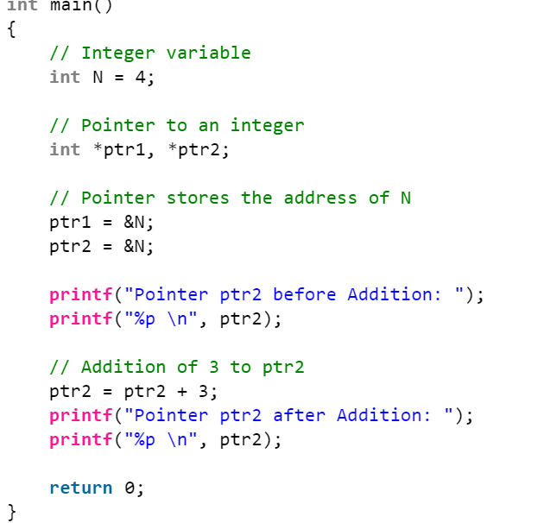
Pointer Arithmetic: Addition

Slide 50
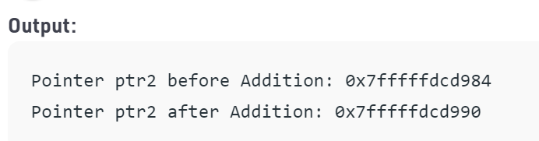
Pointer Arithmetic: Addition

Slide 51
Pointer Arithmetic: Subtraction
Subtraction
When a pointer is subtracted with a value, the value is first multiplied by the size of the data type and then subtracted from the pointer.

Slide 52
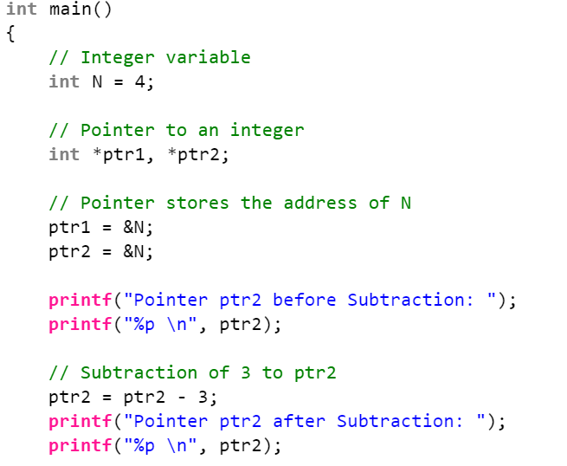
Pointer Arithmetic: Subtraction

Slide 53
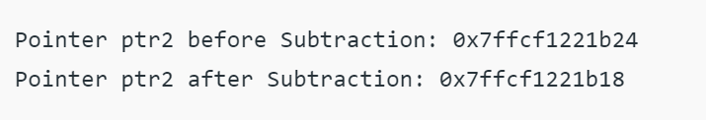
Pointer Arithmetic: Subtraction

Slide 54
C - Command Line Arguments
It is possible to pass some values from the command line to your C programs when they are executed. These values are called command line arguments
The command line arguments are handled using main() function arguments where argc refers to the number of arguments passed, and argv[] is a pointer array which points to each argument passed to the program.

Slide 55
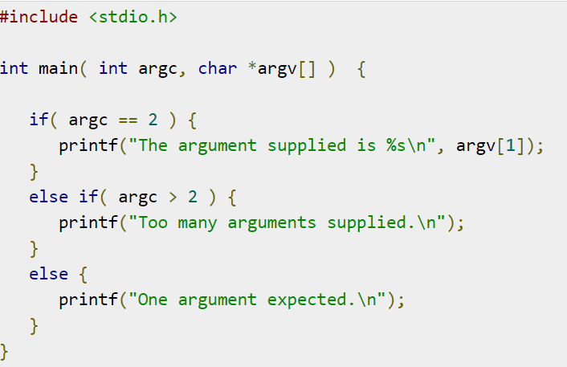
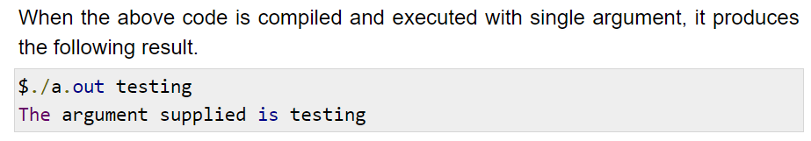
C - Command Line Arguments

Slide 56
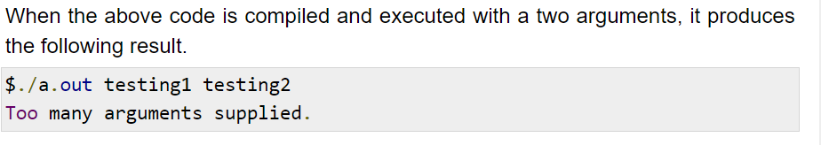
C - Command Line Arguments

Slide 57
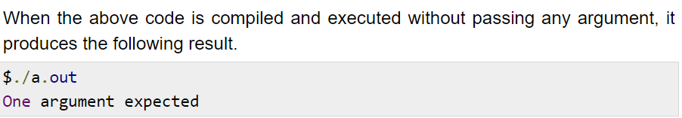
C - Command Line Arguments
Note: It should be noted that argv[0] holds the name of the program itself and argv[1] is a pointer to the first command line argument supplied,

Slide 58
C - Command Line Arguments
Properties of Command Line Arguments:
They are passed to main() function.
They are parameters/arguments supplied to the program when it is invoked.
They are used to control program from outside instead of hard coding those values inside the code.
argv[argc] is a NULL pointer.
argv[0] holds the name of the program.
argv[1] points to the first command line argument and argv[n] points last argument.

Slide 59
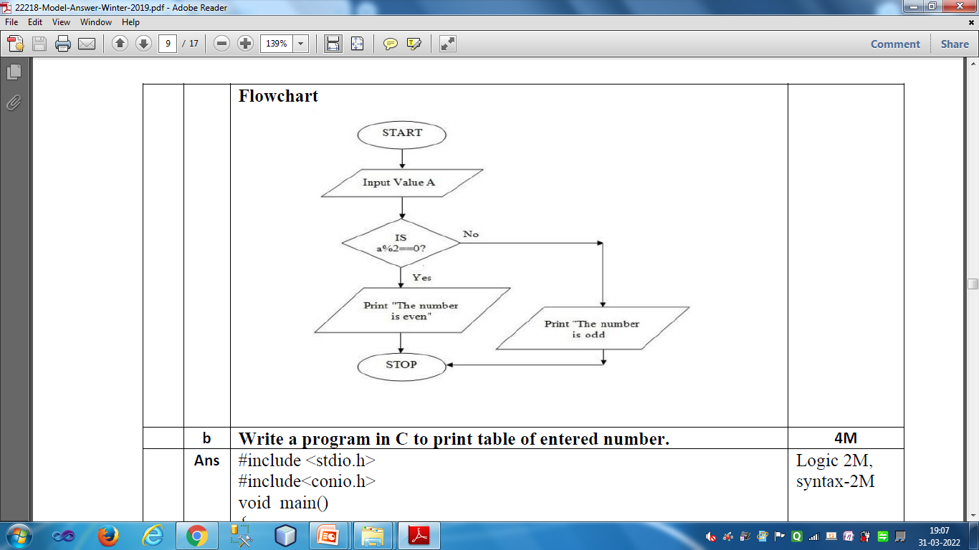

Slide 60
Thank You

